Slide 1








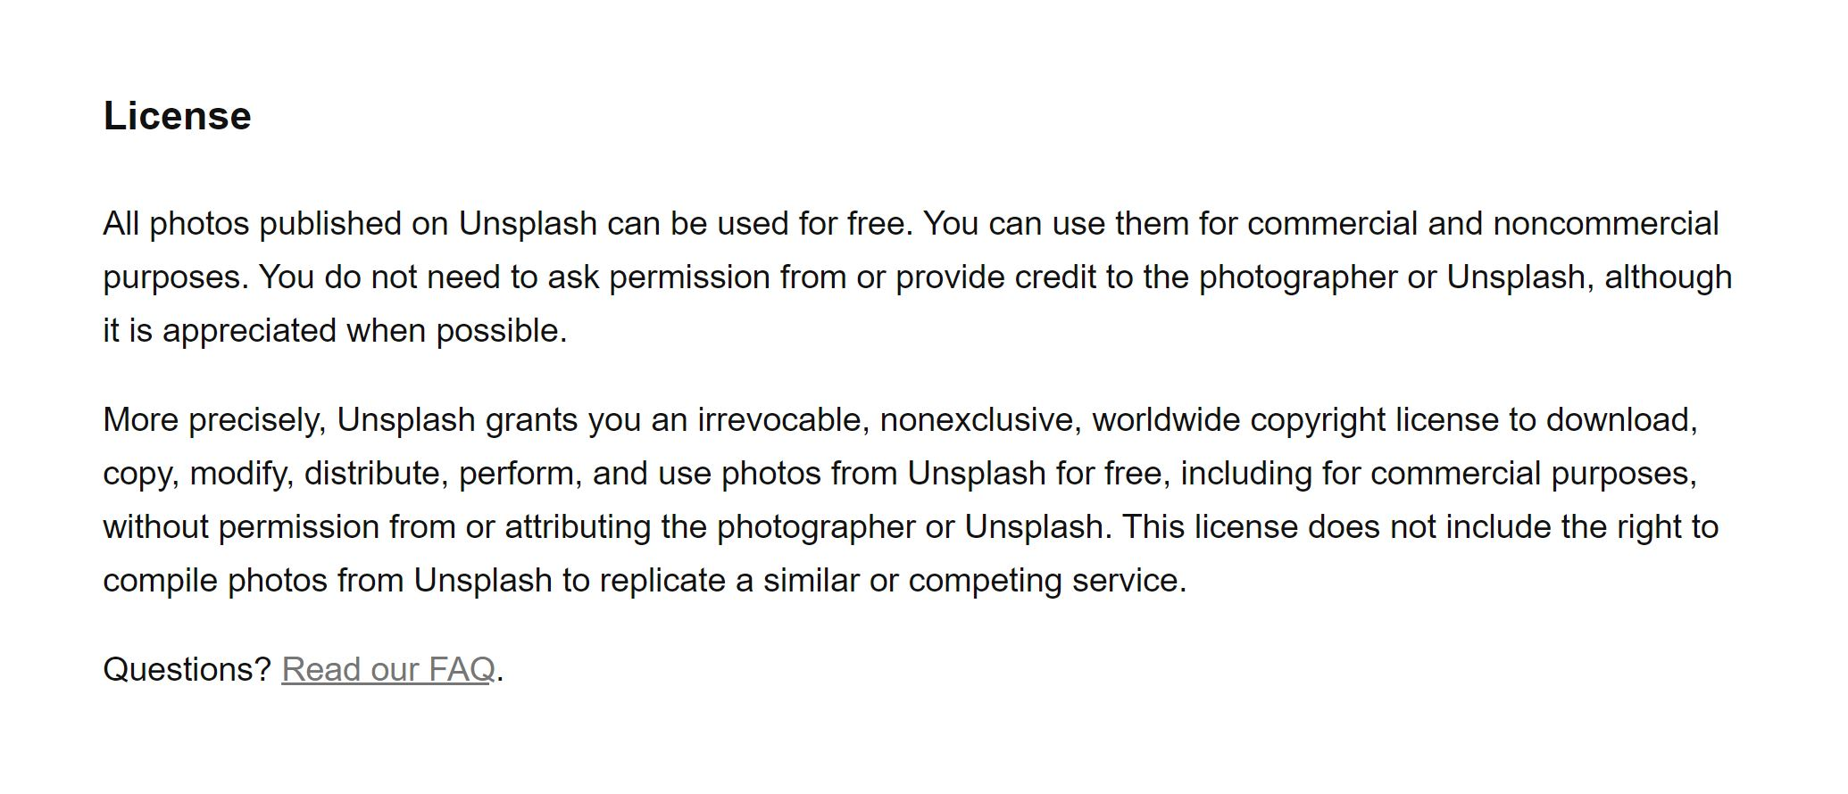











Photos owned by self with signed photo releases on file

